Slide 1
The following few slides are from Chap. 4 of Ben-Ari book

Slide 2
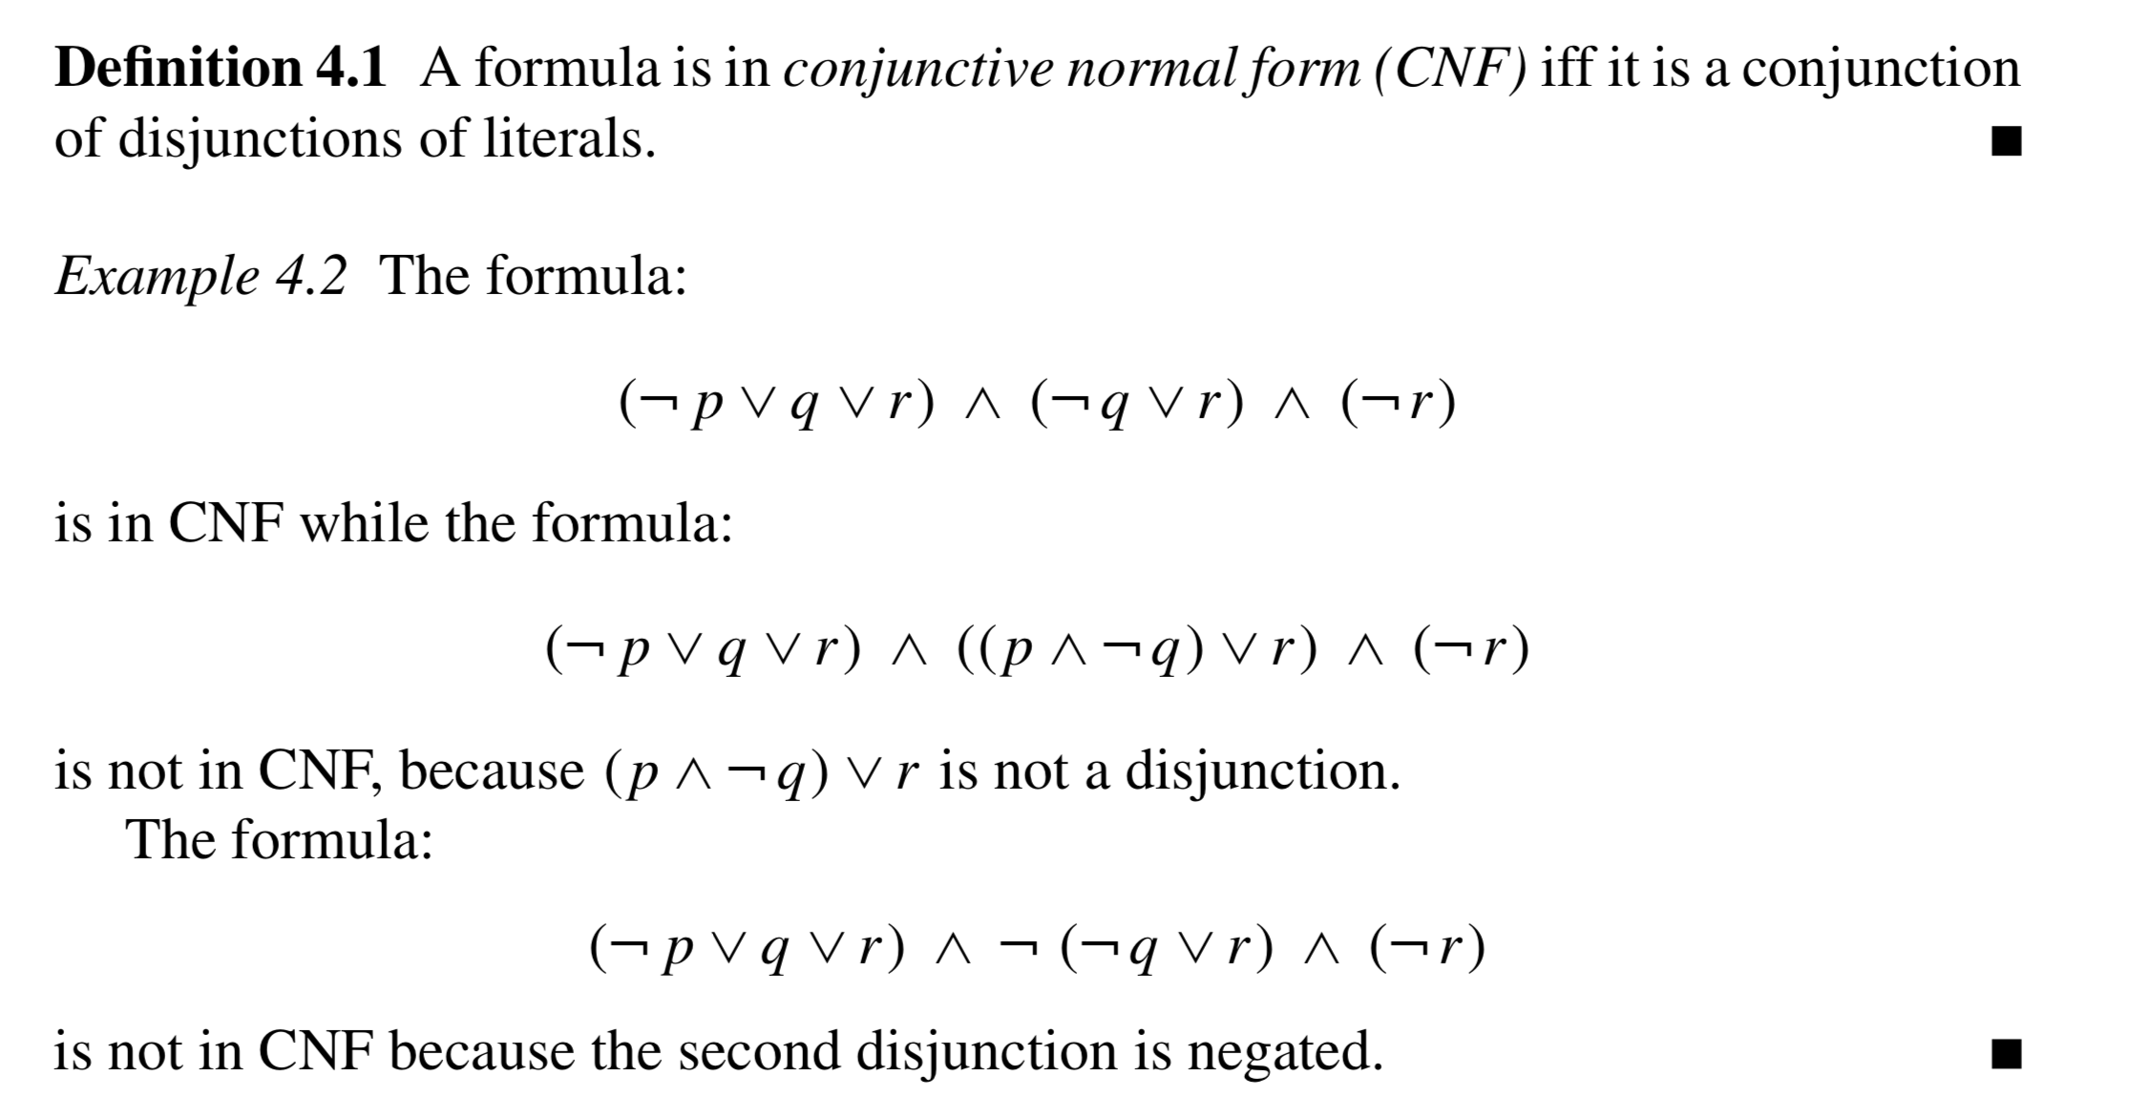

Slide 3



Slide 4



Slide 5


Slide 6


